Slide 1
Efficient Caustics Rendering via Spatial and Temporal Path Reuse
Xiaofeng Xu¹, Lu Wang¹, Beibei Wang^{2,3}
¹Shandong University, China
²Nankai University, China
³Nanjing University of Science and Technology, China
Notes:
Hello everyone! I’m Xiaofeng Xu from Shandong University, China, and I’m presenting our work on ”Efficient caustics rendering via spatial and temporal path reuse”.

Slide 2
Background
What are “caustics” in rendering?
Notes:
I’ll give a little bit of background.

Slide 3
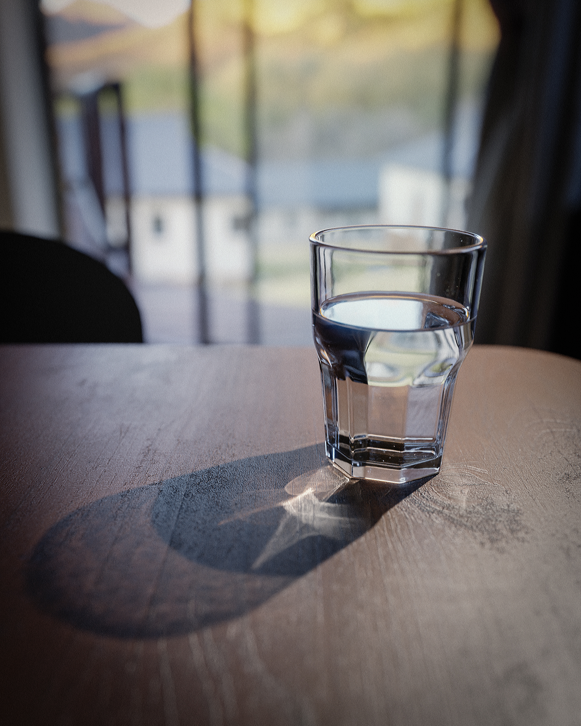
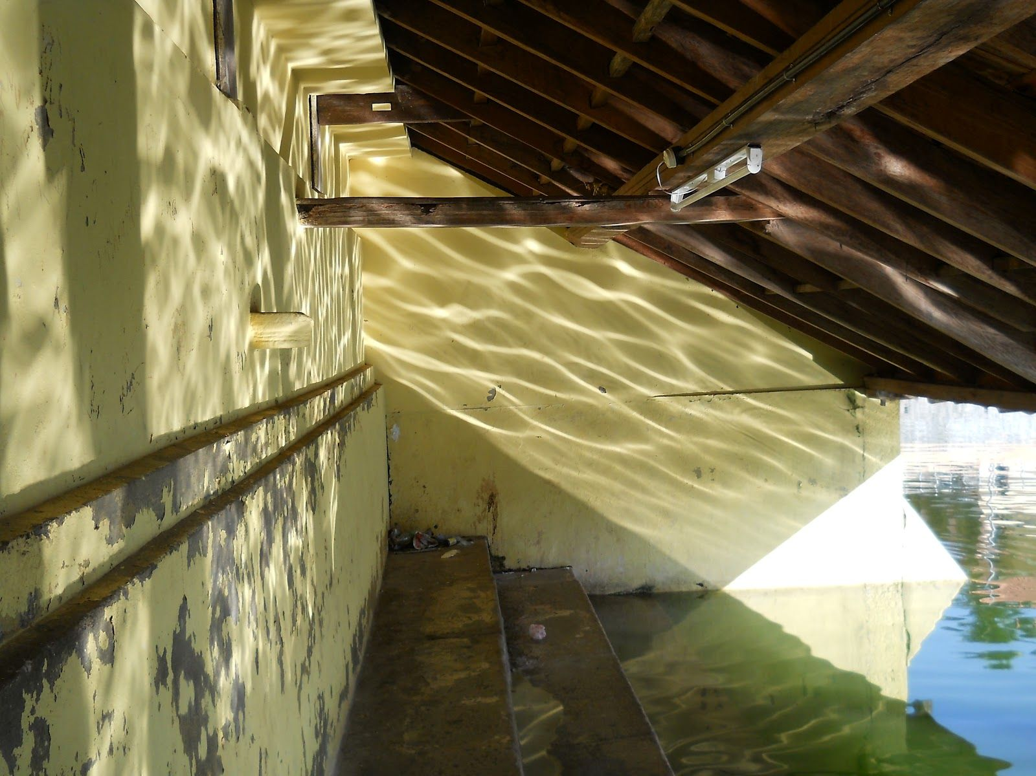
Caustics are everywhere
Notes:
In real life, caustics are a huge part of the lighting contribution of the world.
For example, the sparkle of light that comes from a glass or a body of water that creates interesting highlights.
For anyone that has been involved in the world of 3D rendering — ray tracing, more specifically — you might have some knowledge of what caustics are.

Slide 4
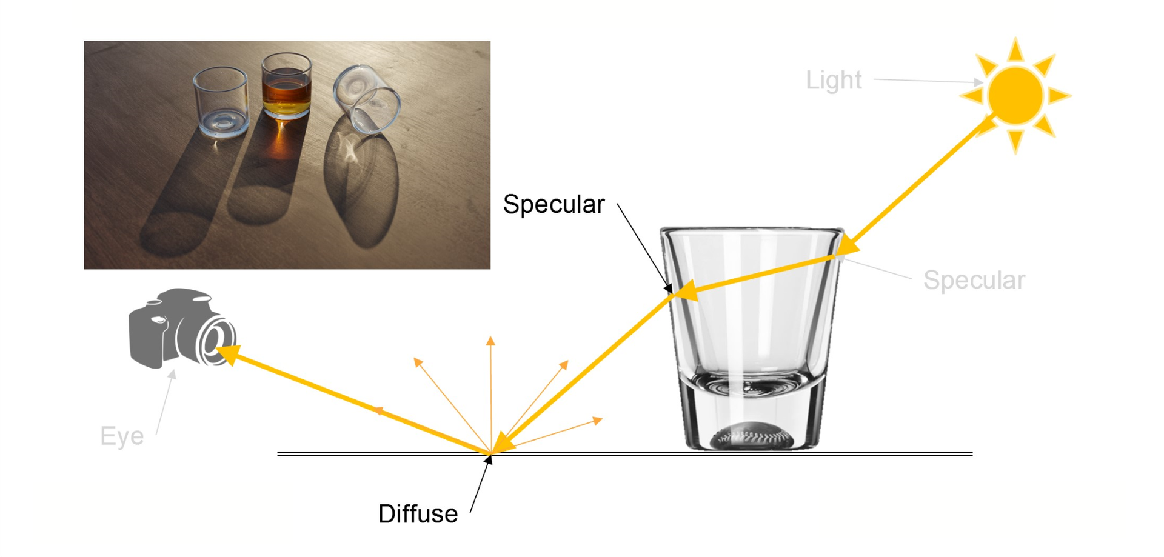
Let’s define caustics
Specular path
“narrow” Hard to find !
from https://www.chaos.com/blog/what-are-caustics-and-how-to-render-them-the-right-way
Notes:
A caustic is any lighting contribution that goes from light source to specular, to diffuse surface, to eye (or camera).
A light path ending with specular-diffuse bounce is called “specular path.”
[click]Finding specular paths can be challenging due to the requirements of reflection and Snell's law at specular interfaces.
[click]The simple way to understand is that the region of the specular paths are narrow, and random Monte Carlo sampling is hard to find such light path.

Slide 5
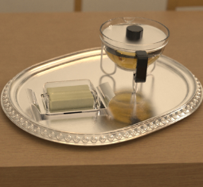
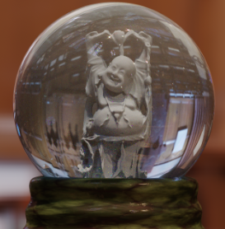
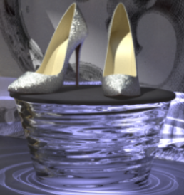
Prior work: specular manifold
Manifold exploration: A MCMC Technique for Rendering Scenes with Difficult Specular Transport
[Jakob and Marschner 2012]
Need seed paths
Local
Manifold Next Event Estimation
[Hanika et al. 2015]
Smooth geometry
Refraction only
Specular Manifold Sampling for Rendering High-Frequency Caustics and Glints
[Zeltner et al. 2020]
Caustics and glints
Time-consuming
5
Notes:
One solution is using the specular manifold to locate valid specular paths.
[click]This approach was first proposed by Jakob and Marschner, it works by solving equations. However, it requires well distributed seed path, and it can only explore local regions near the seed path.
[click]Later on, Hanika and their team expanded on this idea, but they faced difficulties when dealing with complex geometry, and their method only works for refractive caustics.
[click]More recently, Zeltner and their group made improvements by generalizing the method to caustics and glints. But, it's time-consuming.
Our method directly builds on top of this approach. And we make it more efficient.

Slide 6
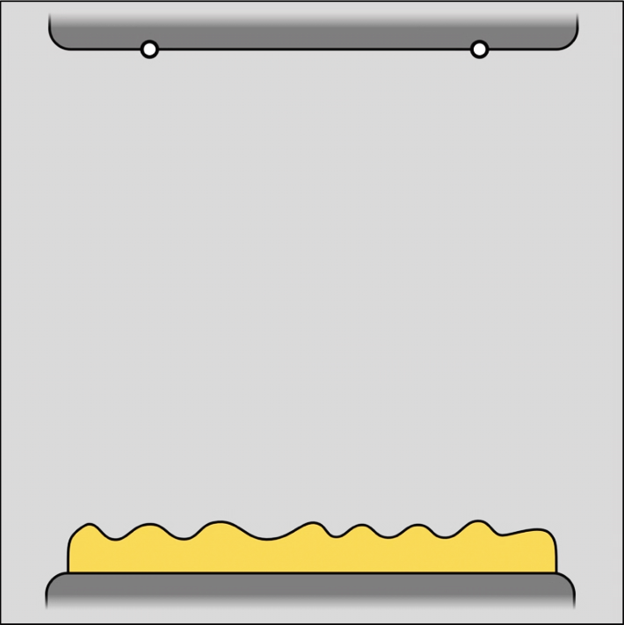
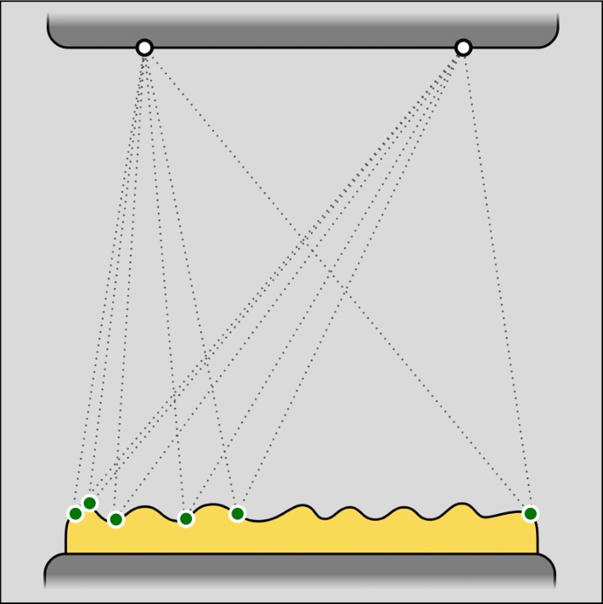
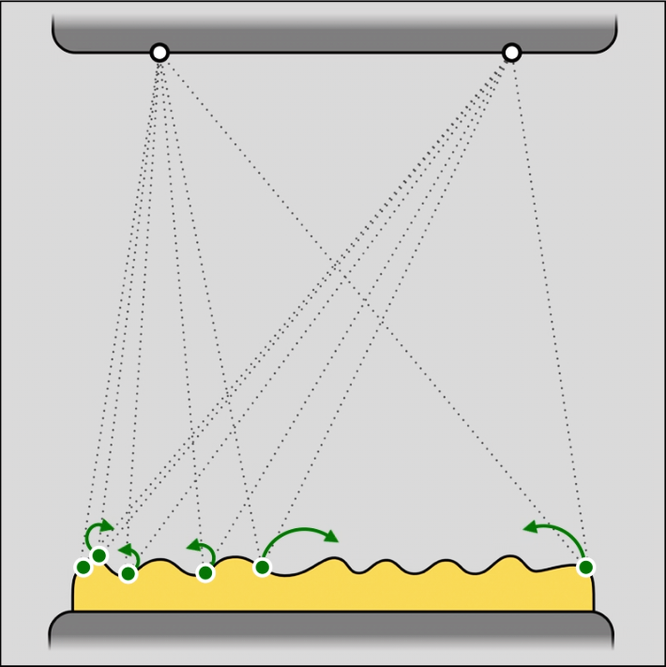
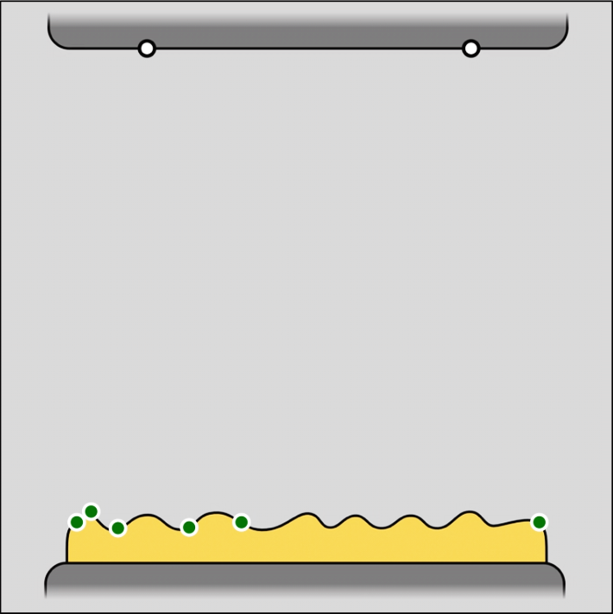
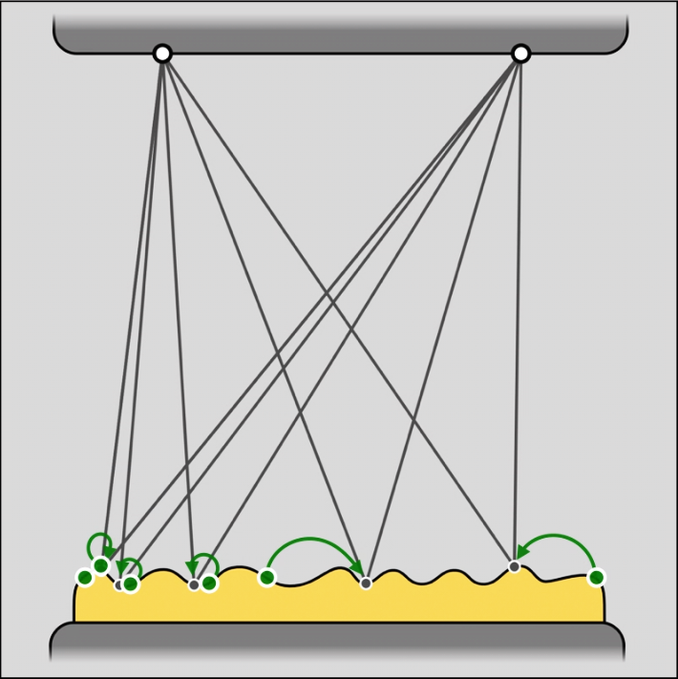
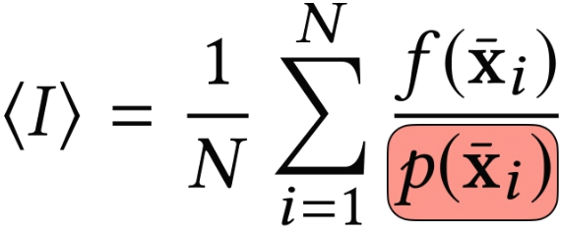
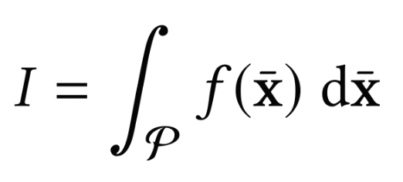
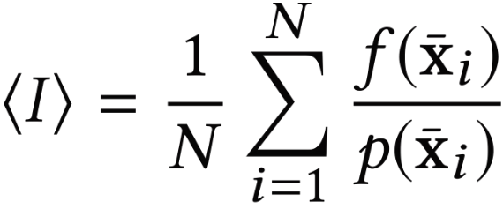
Specular Manifold Sampling [Zeltner et al. 2020]
Diffuse
Light
Find multiple solutions
Manifold walk: 3 steps
1 Sample seed points, e.g. uniformly
2 Connect with endpoints
3 Run Newton solver (manifold walk)
Specular
from https://rgl.epfl.ch/publications/Zeltner2020Specular
Notes:
Now we go into the Specular Manifold Sampling method.
There are two non-specular endpoints, one is a shading point on diffuse surface and the other is a position on light source. The SMS method can find multiple endpoints on the specular surface to generate specular paths.
Three steps are required:
[click]First, sample some seed points on the specular surface randomly;
[click]Next, for each seed points, connect them to the endpoints to form initial paths;
[click]Then, we run the Newton solver on top of those initial paths, and this will give us some solutions that satisfy the specular constraint. [click] In order to use this process as a sampling strategy for Monte Carlo integration. It‘s also necessary to know the probability of generating these paths.

Slide 7
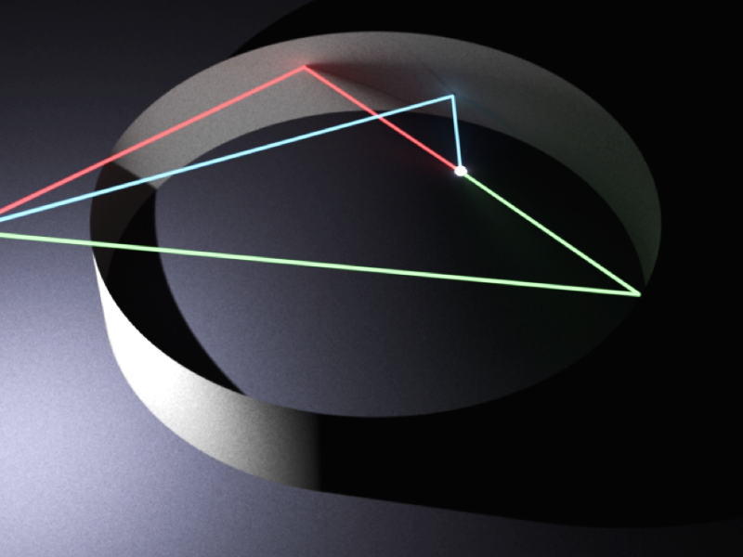
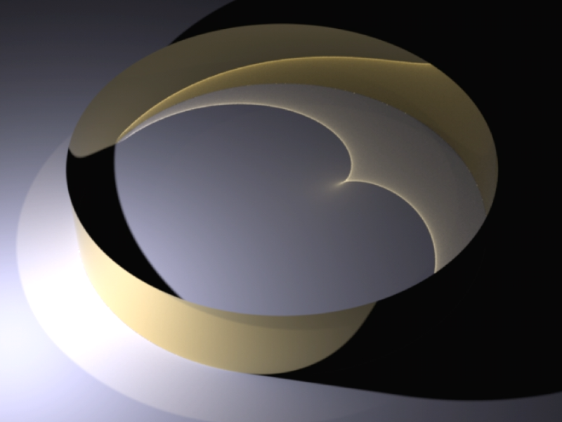
Specular Manifold Sampling [Zeltner et al. 2020]
Multiple solutions
from https://rgl.epfl.ch/publications/Zeltner2020Specular
Notes:
To better understand our method, we now briefly explain how the SMS method calculates this probability.
[click]This is the caustic caused by reflection on a specular ring.
[click]And here is a visualization of a pixel with three specular paths.
To get these specular paths, for instance, by uniformly sampling points on the ring.

Slide 8
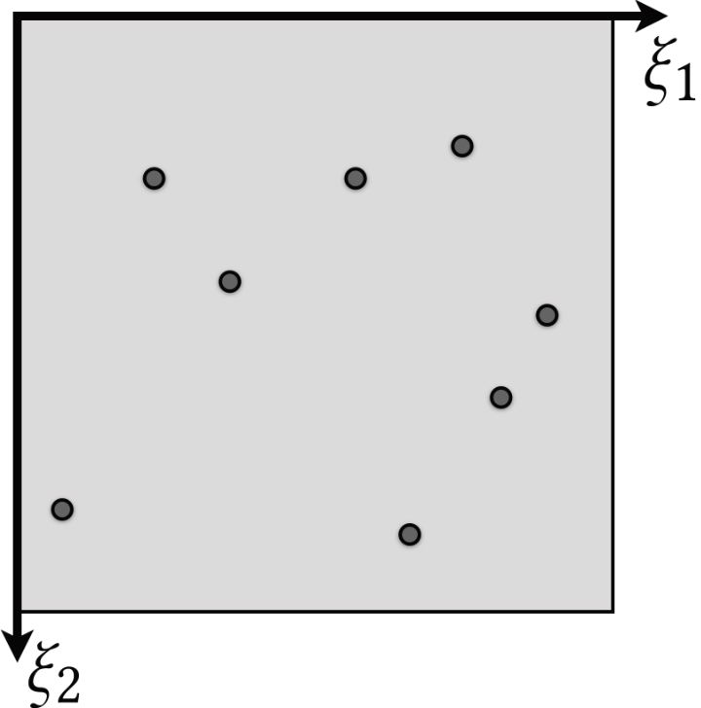
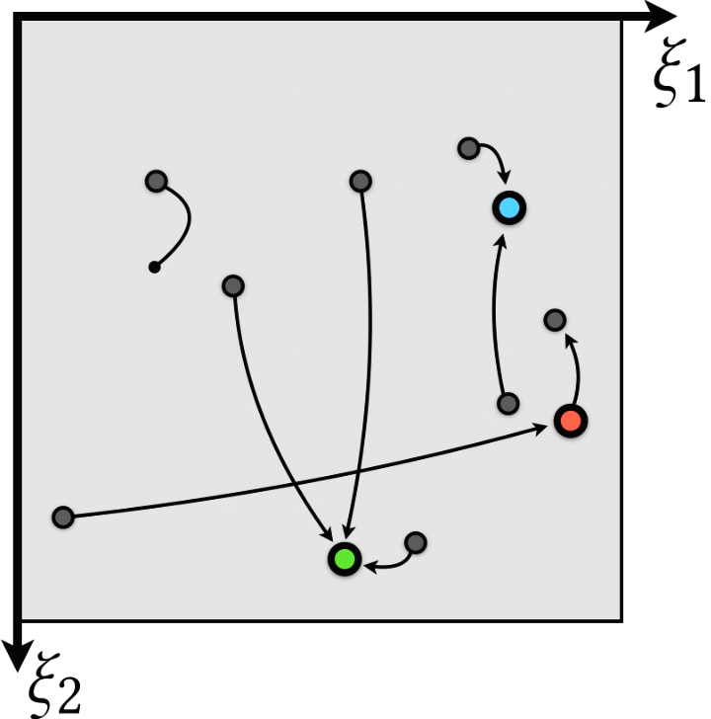
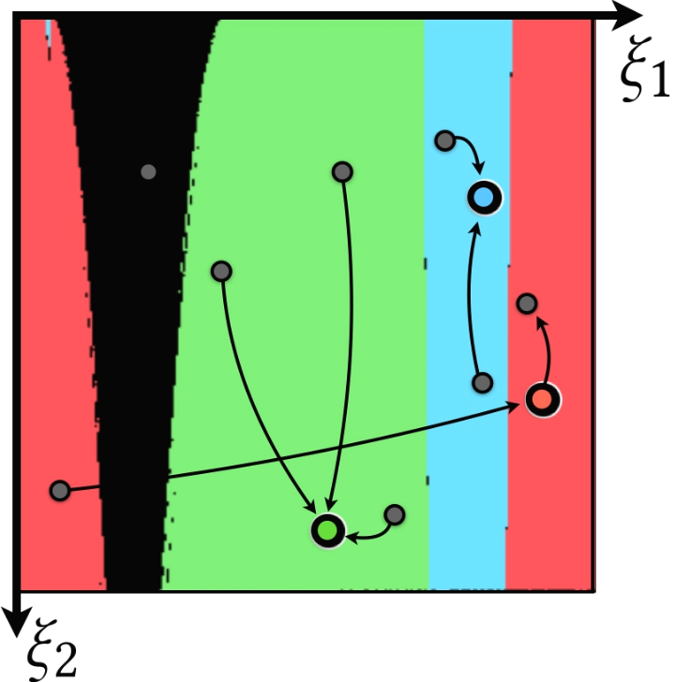
Specular Manifold Sampling [Zeltner et al. 2020]
Multiple solutions
from https://rgl.epfl.ch/publications/Zeltner2020Specular
Notes:
This is a visualization of this process within a 2D primary sample space.
[click]The points in this 2D space correspond to the positions on the ring in the left.
[click] The Newton solver aims to assist each starting point in converging towards one of the solutions marked with colored points.
After Newton iterations for all possible starting points in this 2D space, [click]and this is visualization of the convergence.

Slide 9
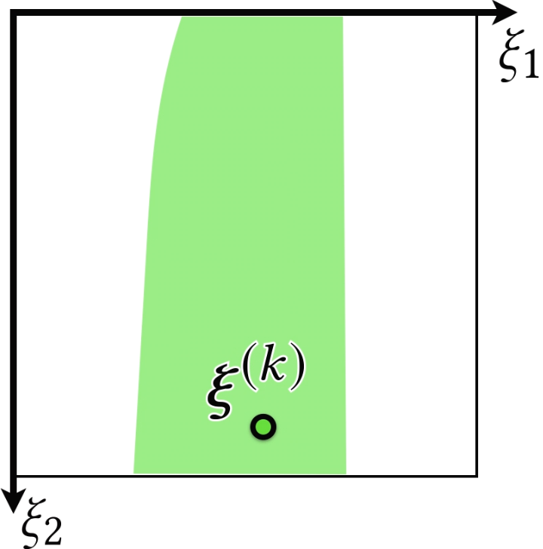
Specular Manifold Sampling [Zeltner et al. 2020]
Probability estimate
Inverse probability estimate
from https://rgl.epfl.ch/publications/Zeltner2020Specular
Notes:
For a single solution, [click]it’s surrounding area is the convergence basin [click]and the area is exactly the probability of finding the solution.
[click] And we need to divide by the probability.
Zeltner et al. introduce two methods to estimate it: an unbiased, and a biased and consistent estimate.

Slide 10
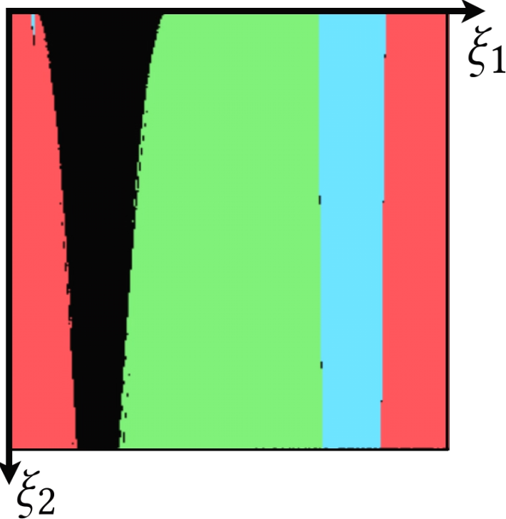
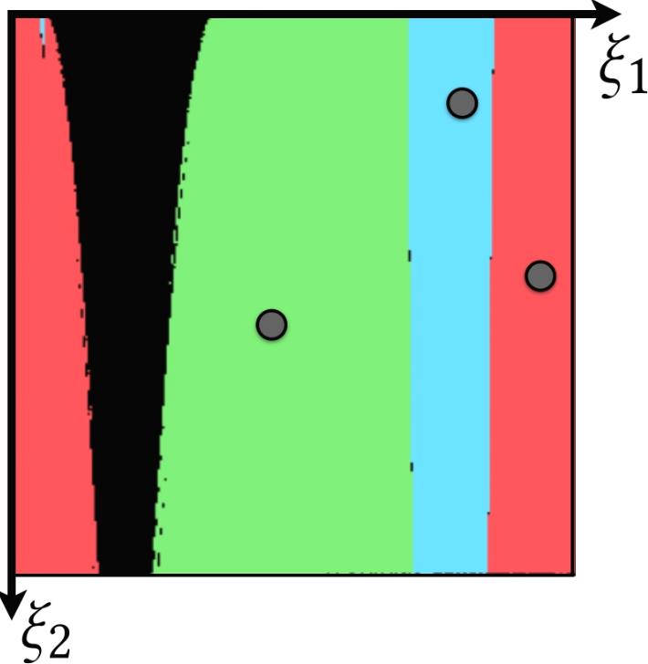
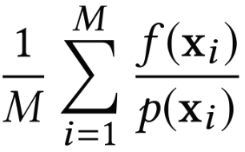
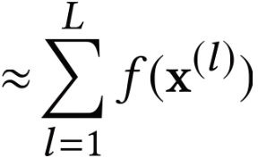
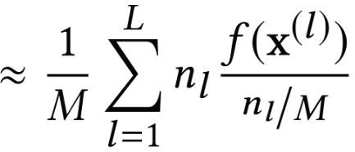
Specular Manifold Sampling [Zeltner et al. 2020]
Biased MC estimator
Bernoulli trials with fixed budget of samples (M)
number of occurrences for each solution
Cluster the M samples into a set of unique solutions (L)
from https://rgl.epfl.ch/publications/Zeltner2020Specular
Notes:
Here I’ll introduce the biased strategy.
[click]Firstly, do M Bernoulli trials, each of them involves a manifold walk step.
[click]Then run a clustering step which returns a set of unique solutions. [click]The probabilities of finding each one can be approximated with the relative number of occurrences for each solution.
The biased estimator for the total throughput then becomes this form[click]

Slide 11
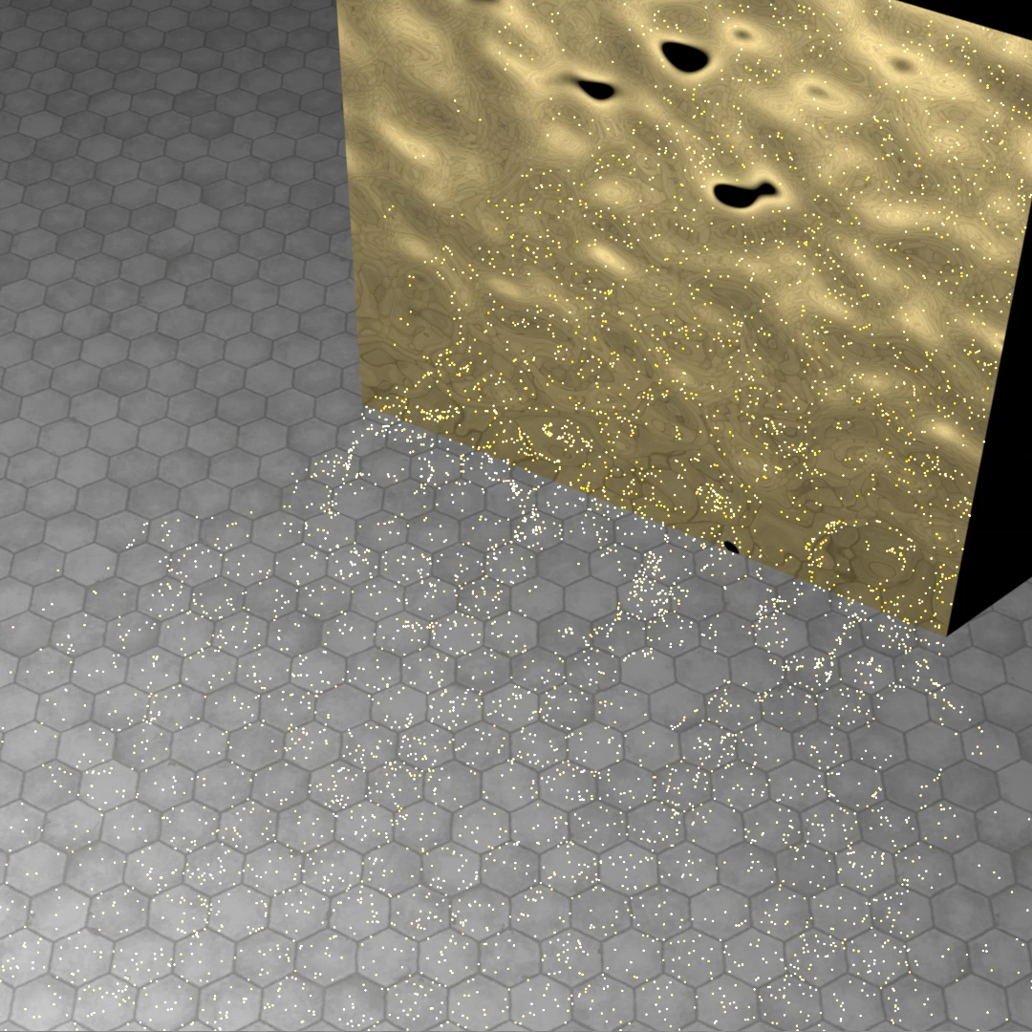
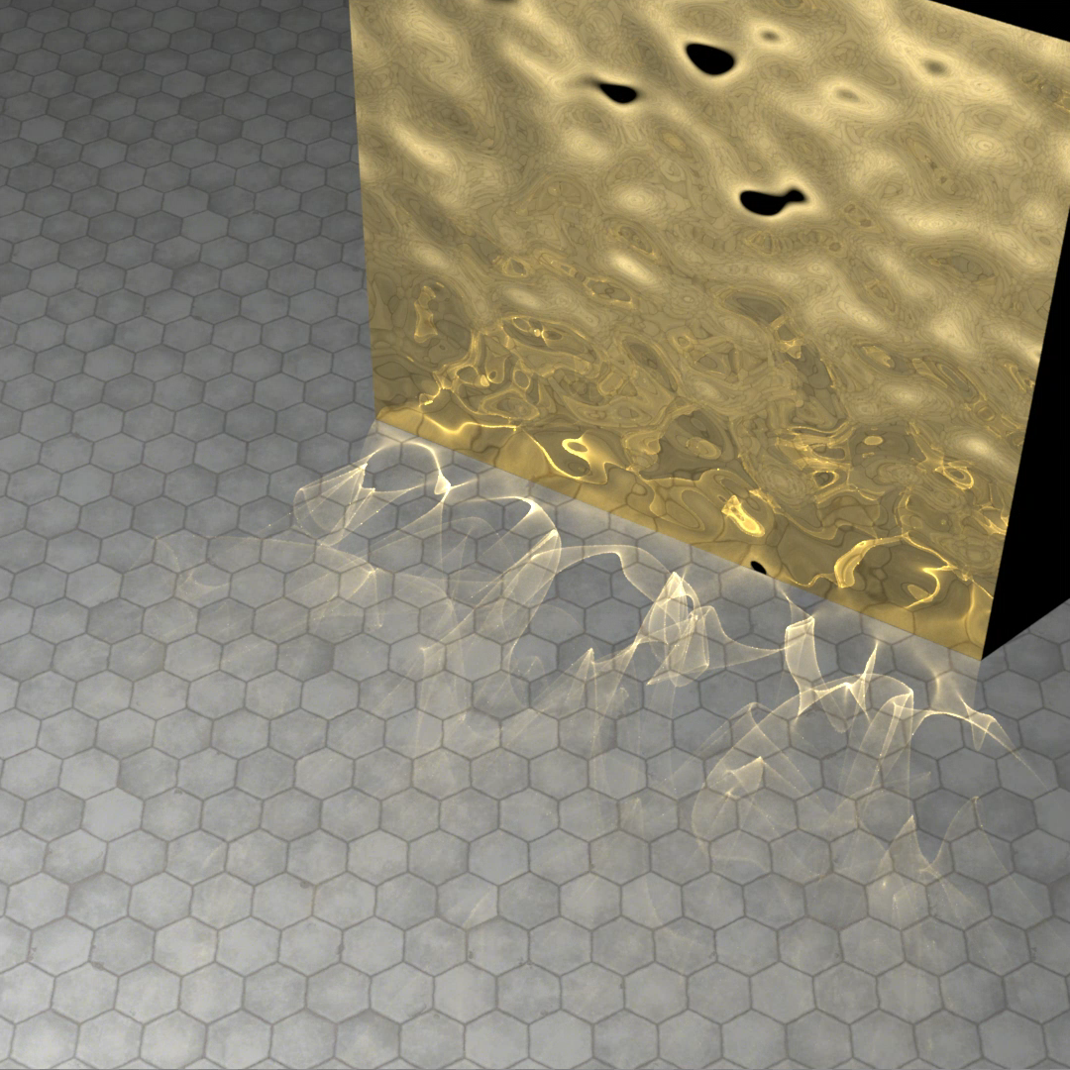
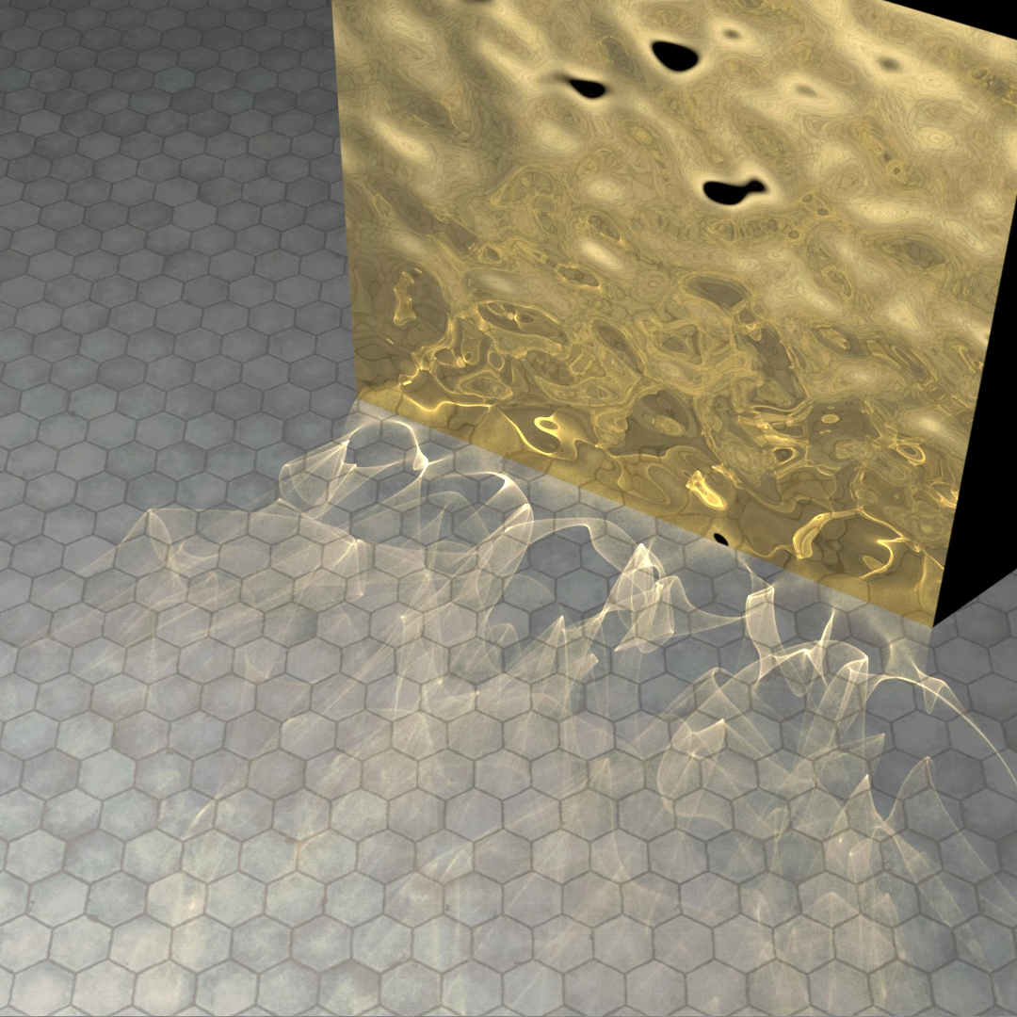
Specular Manifold Sampling [Zeltner et al. 2020]
Path tracing vs. Biased SMS
The biased SMS results in energy loss!
The biased SMS is still time-consuming!
6045 SPP
4 SPP
Path tracing
SMS (Biased)
Reference (PT)
Equal time: 5 mins
Notes:
Compared to a path tracer, biased SMS gives us a much more converged result in equal time.
[click]However, compared to the reference, biased SMS results in energy loss visible as darkening in the caustic regions. [click]In addition, path tracing can generate thousands of samples, while SMS only produces a few. This implies that each SMS path costs nearly 1000 times more than a conventional path. [Click] So, it's important to note that the SMS method is still time-consuming.

Slide 12
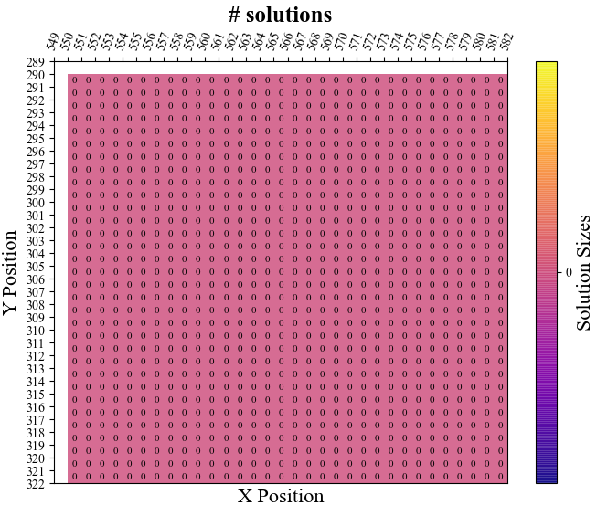
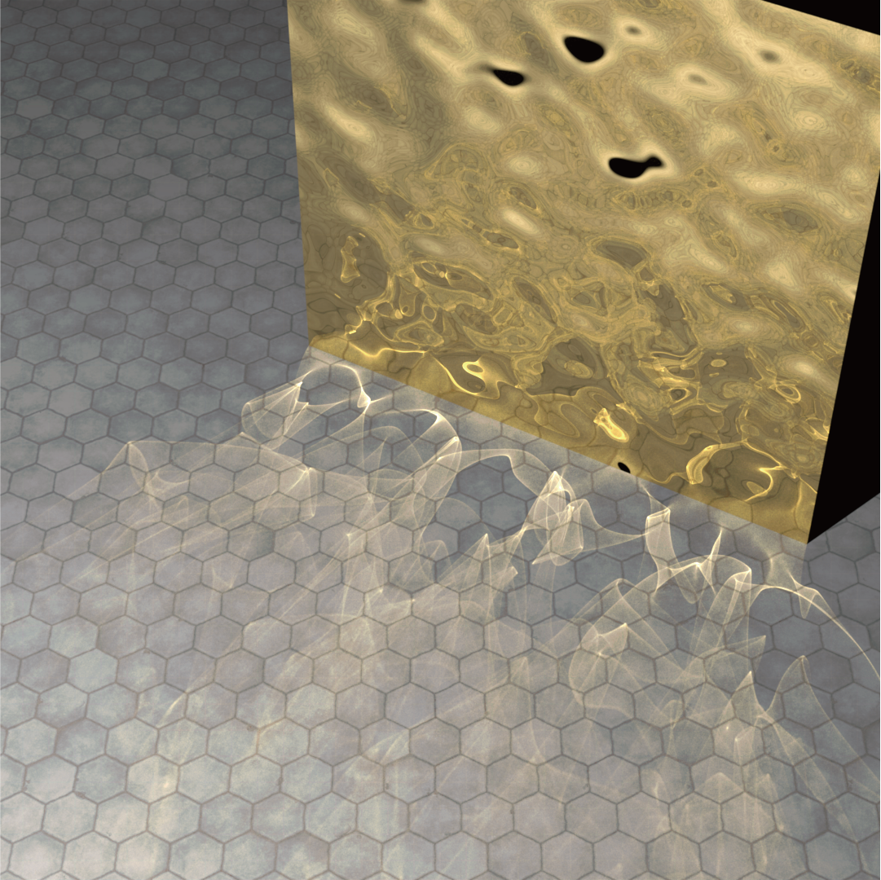
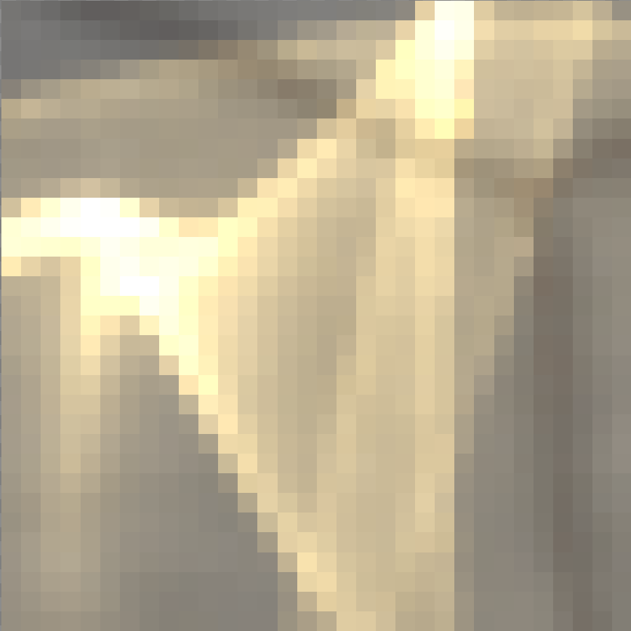
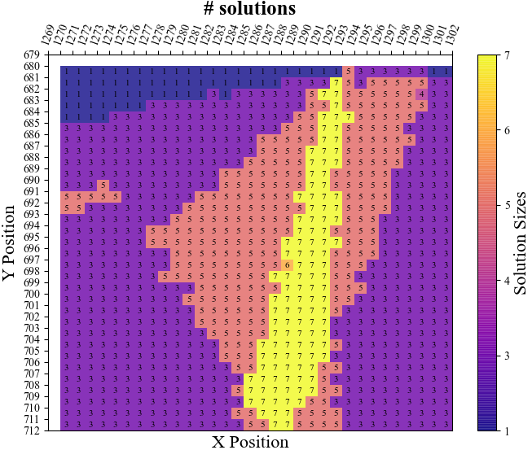
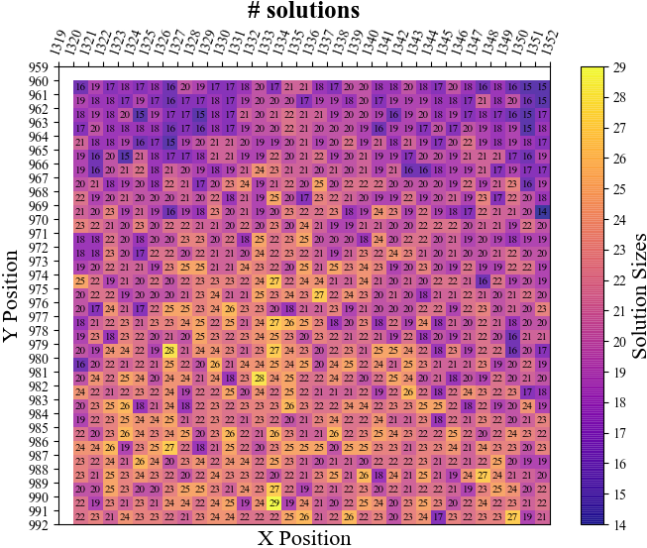
Problem analysis
# solutions
0
7
The biased SMS method is applied uniformly across the entire image. (Number of Bernoulli trials is the same M for all pixels)
29
Notes:
Facing those problems, we have the following analysis. [click]Let's look at the different regions of the image that containing strong, weak and no caustic. And we visualize the number of specular paths in these regions. [click]The number of paths varies with the intensity of the caustic. [click]For example, there is no specular path in this region, but the SMS method also performs time-consuming manifold walk. [click]And in summary, the SMS method only helps with caustics but is applied uniformly across the entire image.

Slide 13
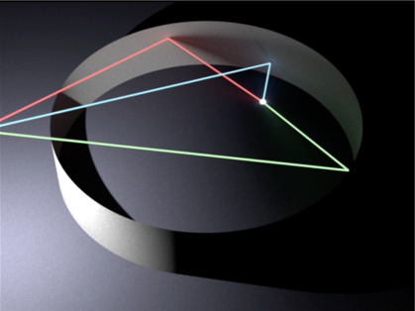
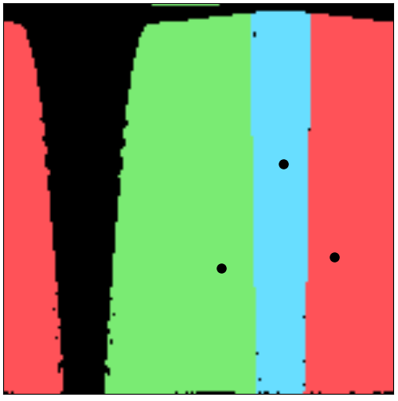
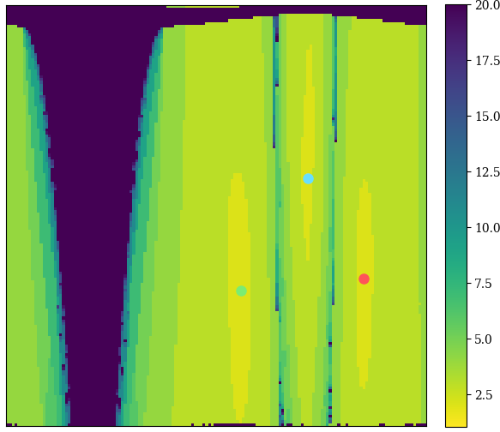
Problem analysis
# Newton iterations
$$ξ_{1}$$
$$ξ_{1}$$
$$ξ_{2}$$
$$ξ_{2}$$
The number of Newton iterations varies with the initial point's distance from the final solution.
Notes:
Let’s look at this example again,
The image on the right shows that starting points in the same basin converge to the same solution. [click]And there is a visualization of the number of Newton iterations required for different initial points. The conclusion is very intuitive. [click]The closer the initial point is to the solution, the fewer iterations are required.

Slide 14
Our method
Simple and practical.
Notes:
Now let’s take a look at our method.

Slide 15
Our goal
To make SMS method more efficient for caustics rendering!
Adaptive!
Fast!
Determining when to use SMS method and how to set the number of Bernoulli trials(M).
How to set up seed points close to the different final solutions?
Notes:
Our goal is to make the SMS method more efficient for caustics rendering!
[click]On one hand, we want it to be adaptive, we need to determine when to use SMS method and set the number of Bernoulli trials M adaptively.
[click]On the other hand, we want it to be faster, we need to set up the seed points as close as possible to the different final solutions.

Slide 16
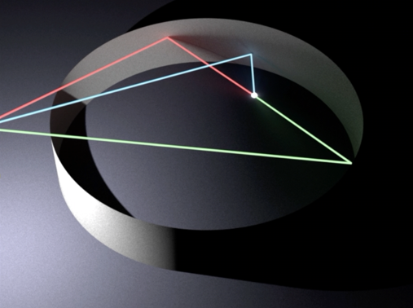
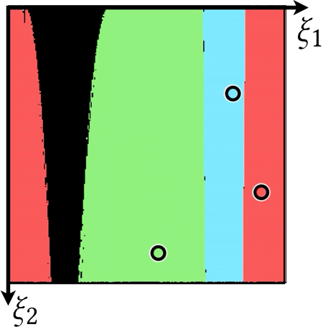
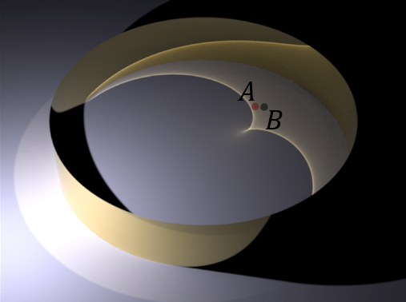
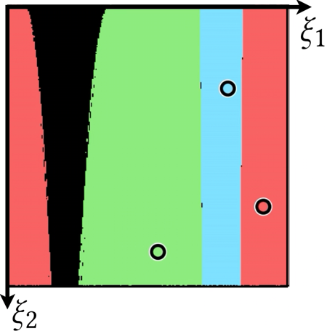
Observation
Smooth Ring
Notes:
Now let’s look at our observation. [click]For two shading points in the Ring scene, the specular paths tend to be similar, [click]and the shapes of their convergence basins in the primary sample space are similar too, and their solutions are close.

Slide 17
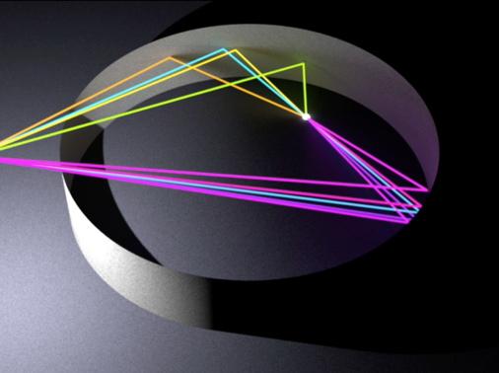
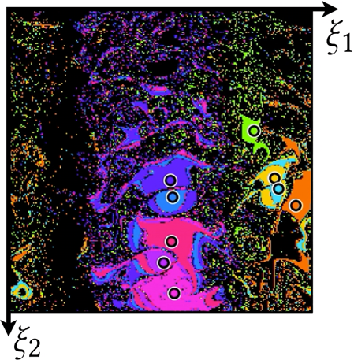
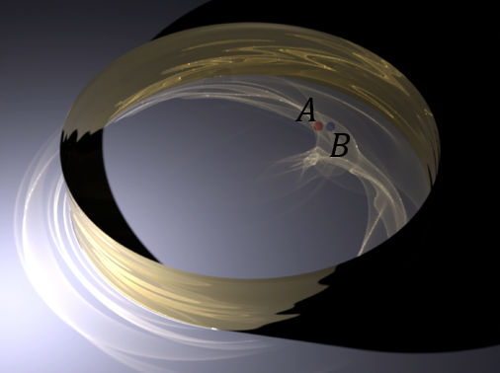
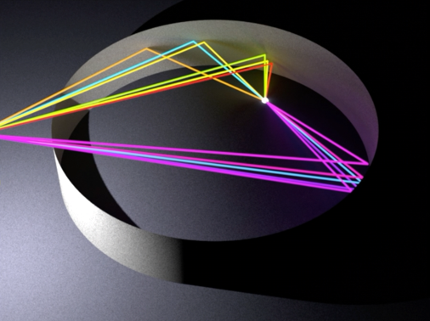
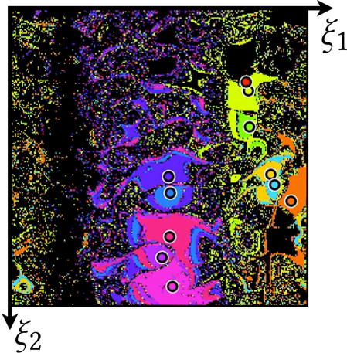
Observation
Ring with a normal map
Neighboring shading points tend to have similar solutions.
Notes:
This similarity holds even when the specular geometry includes a normal map.
[click]Our key observation is that neighboring shading points tend to have similar solutions.

Slide 18
Key idea
Reuse admissible specular paths as the initial guess for manifold walk.
(Both in the spatial and temporal domain)
Utilize the neighborhood information to determine not to perform manifold walk where no solution exists.
Notes:
Building on this observation, [click]we propose to reuse admissible specular paths as the initial guess for manifold walk in spatial domain.
[click]Then, in regions without caustics where no solution exists, we utilize the spatial information to decide not to perform manifold walk.
And we extend this reuse strategy from spatial to temporal domain.

Slide 19
Key idea
SMS
Our method
$$x_{3}$$
$$x_{3}$$
$$x_{2}$$
$$x_{2}$$
$$x_{0}$$
$$x_{0}$$
Higher manifold walk success rate.
Fewer Newton iterations.
$$x_{1}$$
$$x_{1}$$
:fixed position
:random samples
:success manifold walk
:recorded samples
:valid solutions
:failing manifold walk
Notes:
Here's the comparison between our method and the SMS method.
The SMS method chooses the seed points by sampling uniformly over the specular geometry,
[click]while our method starts from the recorded samples.
These recorded samples are obtained through spatial and temporal reuse.
Compared with the SMS method, [click]our method leads to a higher manifold walk success rate and fewer Newton iterations.

Slide 20
Overview
Random samples(uniform)
SMS
pixel i-1
Spatial reuse
Solutions over adjacent pixels
M
Temporal reuse
Solutions
from last frame
Specular Manifold Sampling
SMS
pixel i-1, i, i+1
SMS
pixel i
Success Solutions
L
SMS
pixel i+1
First phase
Second phase
Notes:
Our method includes two phases. [click]In the first phase, we generate admissible specular paths with a lower sample rate using the biased SMS method.
[click]In the second phase, we reuse those specular path samples and share them in the spatial domain. [click] We also reuse the specular path samples from the previous frame in the temporal domain.

Slide 21
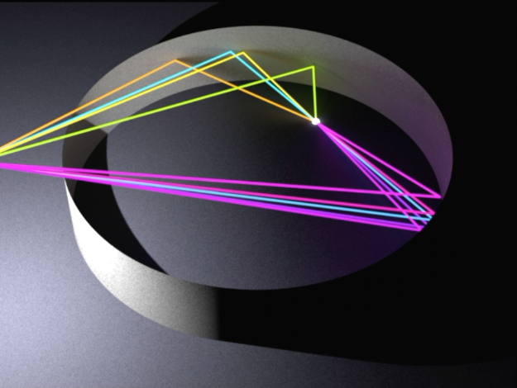
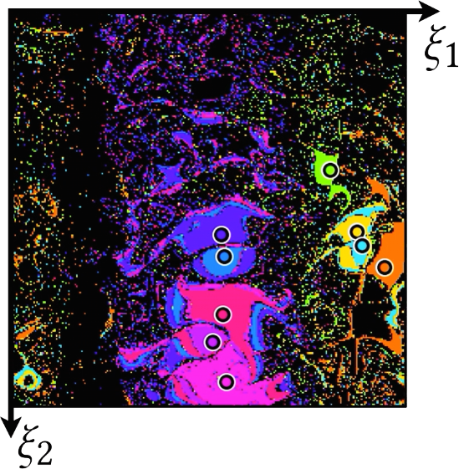
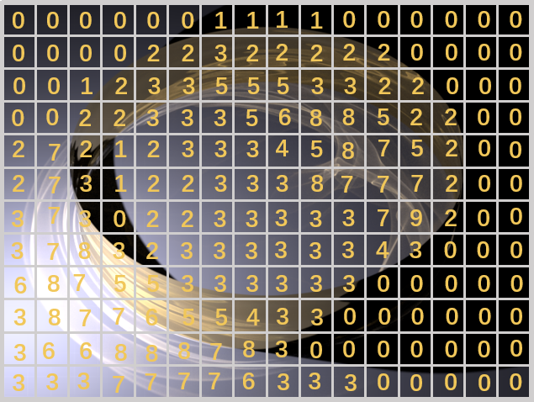
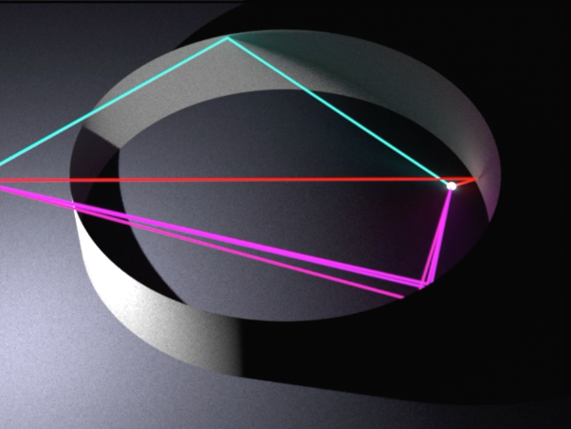
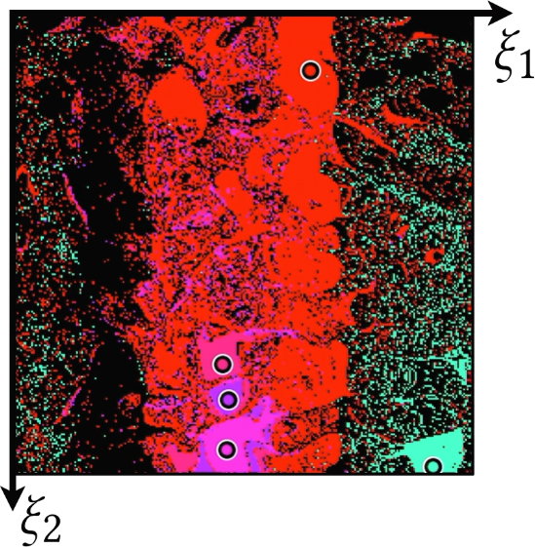
First phase: generate specular path samples
📍 Points position
# solutions
8
5
……
……
Biased SMS
with less budget
3
Notes:
In the first phase, for every pixel, we run Biased SMS method with a limited number of Bernoulli trials and a few SPP.
[click]We generate specular path samples for each pixel.

Slide 22
First phase: generate specular path samples
# solutions
📍 Points position
Notes:
After that, we obtain all specular light path samples’ information, including the number of specular paths and their corresponding points on the specular geometry.
Note that this step is quite efficient since the specular path samples are generated with much less budget than the rendering.

Slide 23
Second phase: spatial reuse
Reuse size:
de-duplicated
Notes:
In the second phase, we share those information with adjacent pixels.[click]Pixels in the same reuse range share the specular path sample information of each other, and those shared paths are de-duplicated based on their respective pixel’s shading point.

Slide 24
Second phase: temporal reuse
f_{i}
f_{i -1}
f_{i}
Merge pixel by pixel
Notes:
Our reuse process extends to the temporal domain for scenes with dynamic lighting or deformation of specular geometry. We leverage information from the previous frame by merging the recorded specular path samples pixel by pixel.

Slide 25
Result
Notes:
Finally, let’s take a look at our results

Slide 26
Comparison of the average number of Newton iterations
The calculation includes both success and failing manifold walks.
# Newton iterations for all test scenes
≈10%
≈ 7%
≈16%
≈22%
Notes:
This table shows the average number of Newton iterations for all test scenes.
The SMS method employs a two-stage sampling method for the first threes scenes with normal map, while only the second stage is used for the slab scene without normal map. And our method only utilizes the second manifold walk during the reuse phase. [click]Obviously, our method significantly reduces the number of iterations.

Slide 27
Equal time comparison: refractive sphere
27
Notes:
Here is an equal time comparison of the refractive sphere scene.
Previous work “specular manifold sampling”, of course improves a lot than a standard path tracing, but there is still some energy loss compared to the reference image.
[click]Our method can achieve more SPP, and efficiently recover the lost energy, produce caustic brightness similar to the reference image.

Slide 28
Equal time comparison: refractive sphere
Notes:
Here's a video comparison of the results.

Slide 29
Equal time comparison: double refractive slab
Notes:
Our method can handle long chains with multiple specular interactions.
Here is an equal time comparison of the double refractive slab. Our method still produces good results.

Slide 30
Equal time comparison: double refractive slab
Notes:
Here‘s a video comparison.

Slide 31
Spatial reuse size
Notes:
Here, we show the performance of our method under different spatial reuse size.
As the range of spatial reuse increases, the rendering time increases and the image quality improves. However, this improvement is not linear, [click]and a larger size of reuse becomes unnecessary at a certain point.

Slide 32
Increasing roughness
reuse size: 2×2
reuse size: 4×4
Notes:
As roughness increases, PT becomes more capable of directly connecting to the light source, whereas the SMS method loses efficiency.
[click]By increasing the size of spatial reuse, our approach can achieve better results compared to the SMS method.

Slide 33
Moving light source
w/o temporal reuse
spatial(4×4)
w/ temporal reuse
spatial(4×4)
Notes:
In addition to spatial reuse, our approach can be extended to scenes with dynamic lighting.
The result with temporal reuse utilizes the path sample information recorded before the rotation of the light source in the previous frame. The results show that temporal reuse can improve the rendering quality of complex caustic regions.

Slide 34
Deformation of specular geometry
Gaussian
filter
w/o temporal reuse
spatial(4×4)
w/ temporal reuse
spatial(4×4)
Notes:
Our method can also be used for movement and deformation of specular geometry.
Here we show the results of deforming the specular geometry.
We perform a Gaussian filter operation on the normal map to deform the specular geometry. The result of temporal reuse utilizes the path sample information generated by the more complex specular geometry of the previous frame.

Slide 35
Conclusion
Notes:
Let's conclude.

Slide 36
Conclusion
A specular path reuse approach both in the spatial and temporal domain for efficient caustics rendering.
Limitations
Limited roughness.
Large light sources.
Notes:
We propose an efficient caustics rendering method via spatial and temporal reuse.
Our method is adaptive and fast.
[click]Our method has limitations. It loses effectiveness when dealing with high roughness and large light sources (such as environment map or large area light source). This is due to the significant difference in specular paths between neighboring shading points. The manifold walk success rate of our spatial and temporal reuse is reduced.

Slide 37
Efficient Caustics Rendering via Spatial and Temporal Path Reuse
Thank you!
^{Q&A}
Notes:
That’s all and thank you.

